Slide 1
Parallel Image clustering
Evgeniy Garsiya, Ivan Anisimov, Victor Adamovich, Lina Bashaeva

Slide 2
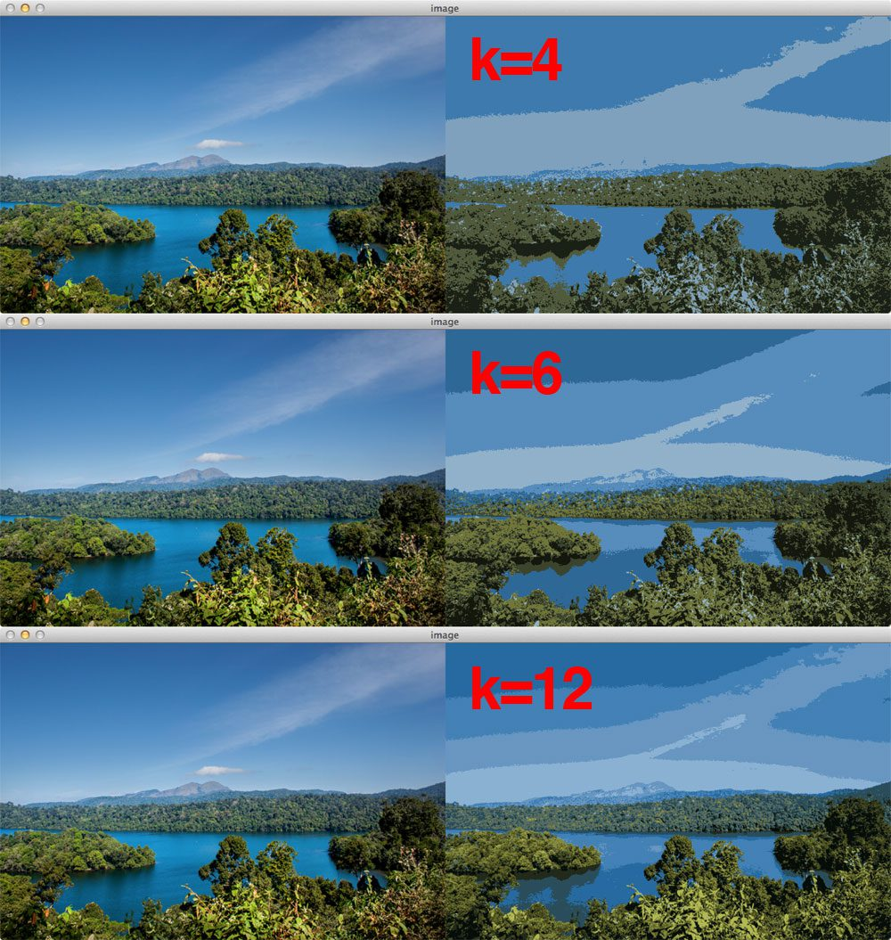
Image segmentation is the process of partitioning an image into multiple different regions (or segments). The goal is to change the representation of the image into an easier and more meaningful image.
K-means clustering is an unsupervised machine learning algorithm that aims to partition N observations into K clusters in which each observation belongs to the cluster with the nearest mean. A cluster refers to a collection of data points aggregated together because of certain similarities. For image segmentation, clusters here are different image colours.

Slide 3
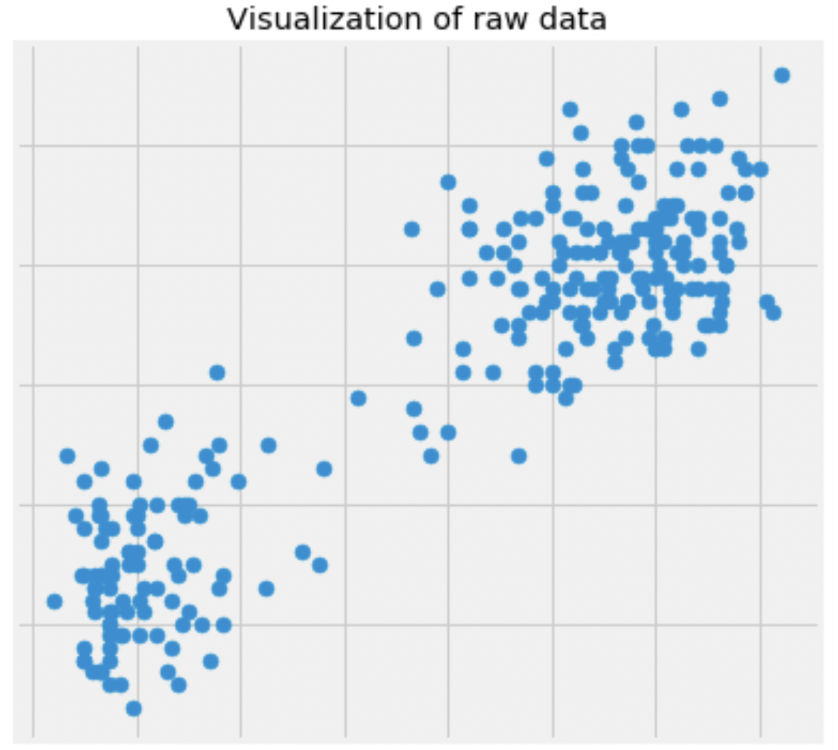
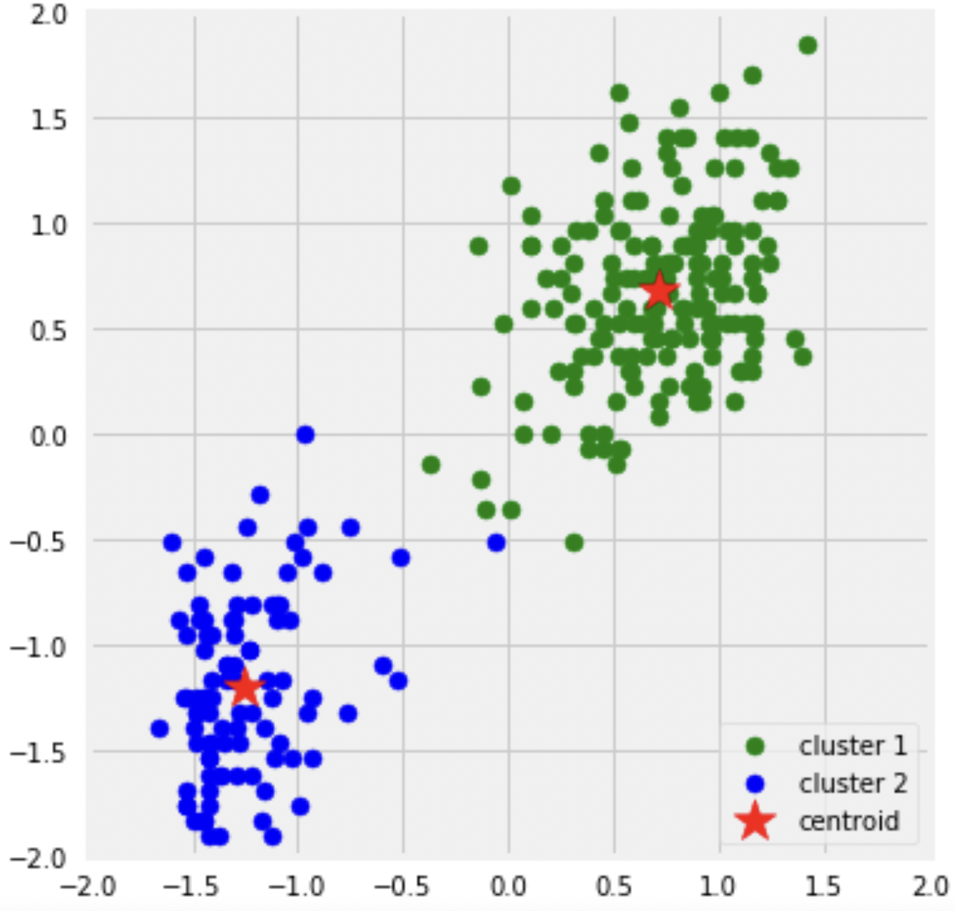
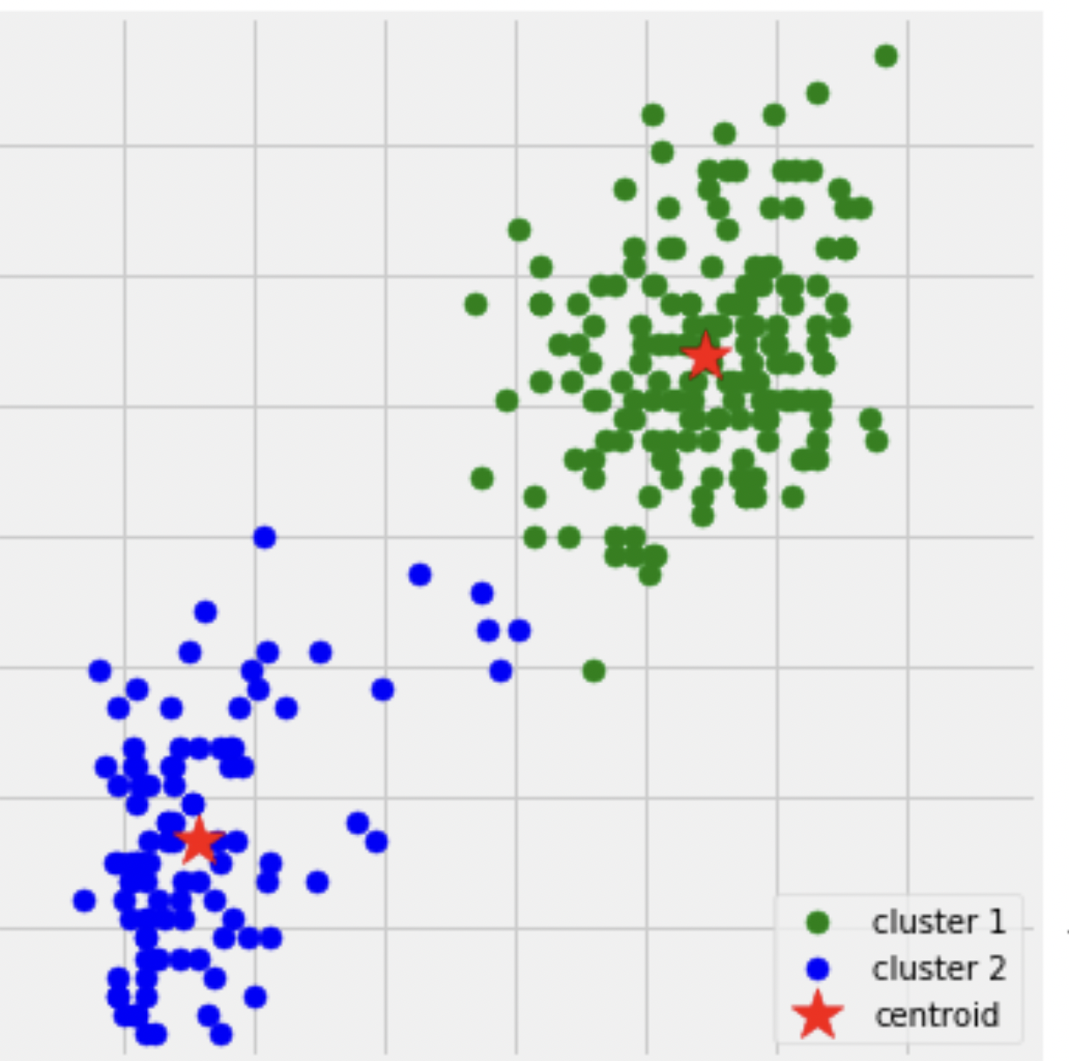
Initialize data
Random
centroids
C2
D2
Moved
centroids
If distance D1 from point P to centroid C1 is less then distance D2, we will refer point P to cluster of centroid C1
P
D1
Until
converge
C1

Slide 4
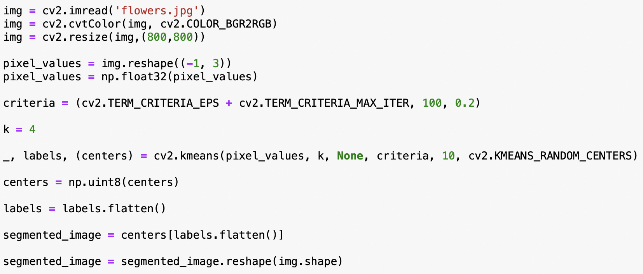
Critical number of centroid moving = 0.2
Critical number of iterations = 100
Number of clusters
0, 1, 2 or 3 (since k = 4)
convert all pixels to the color of the centroids

Slide 5
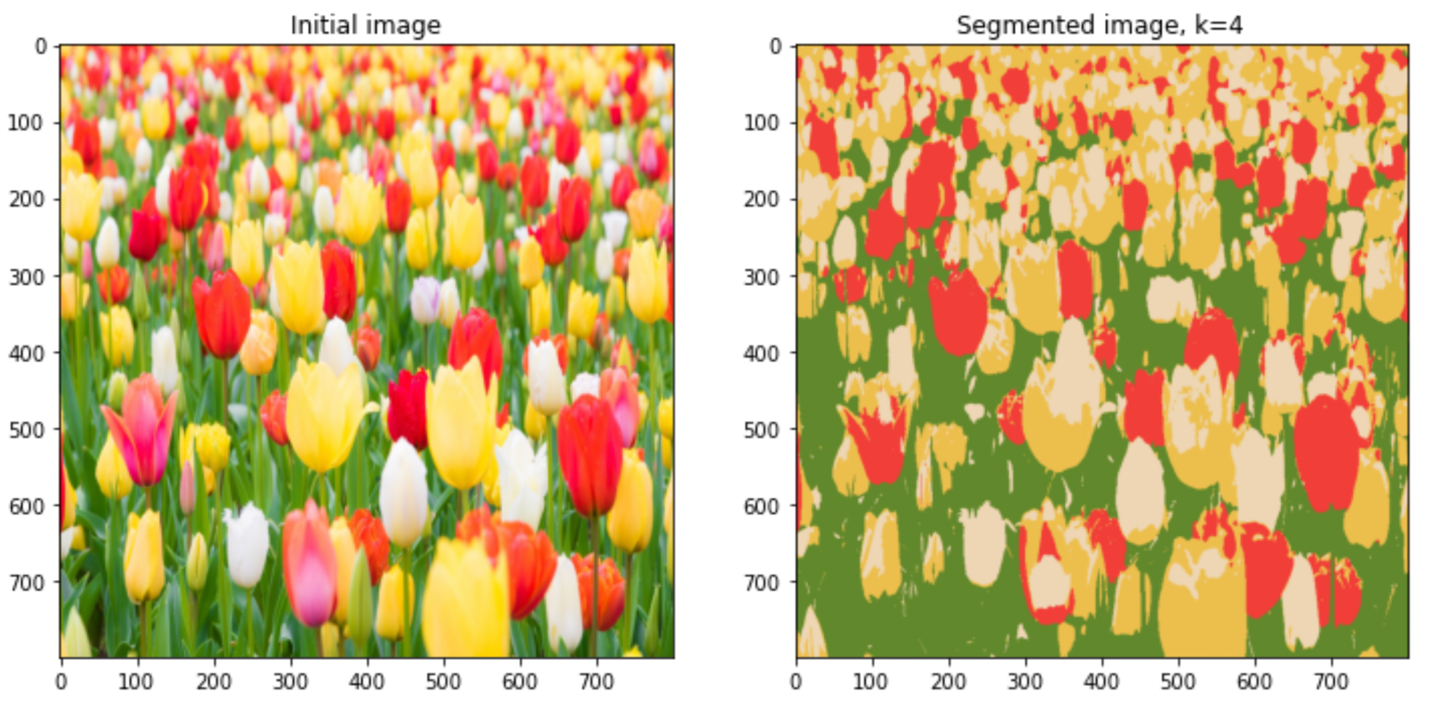

Slide 6
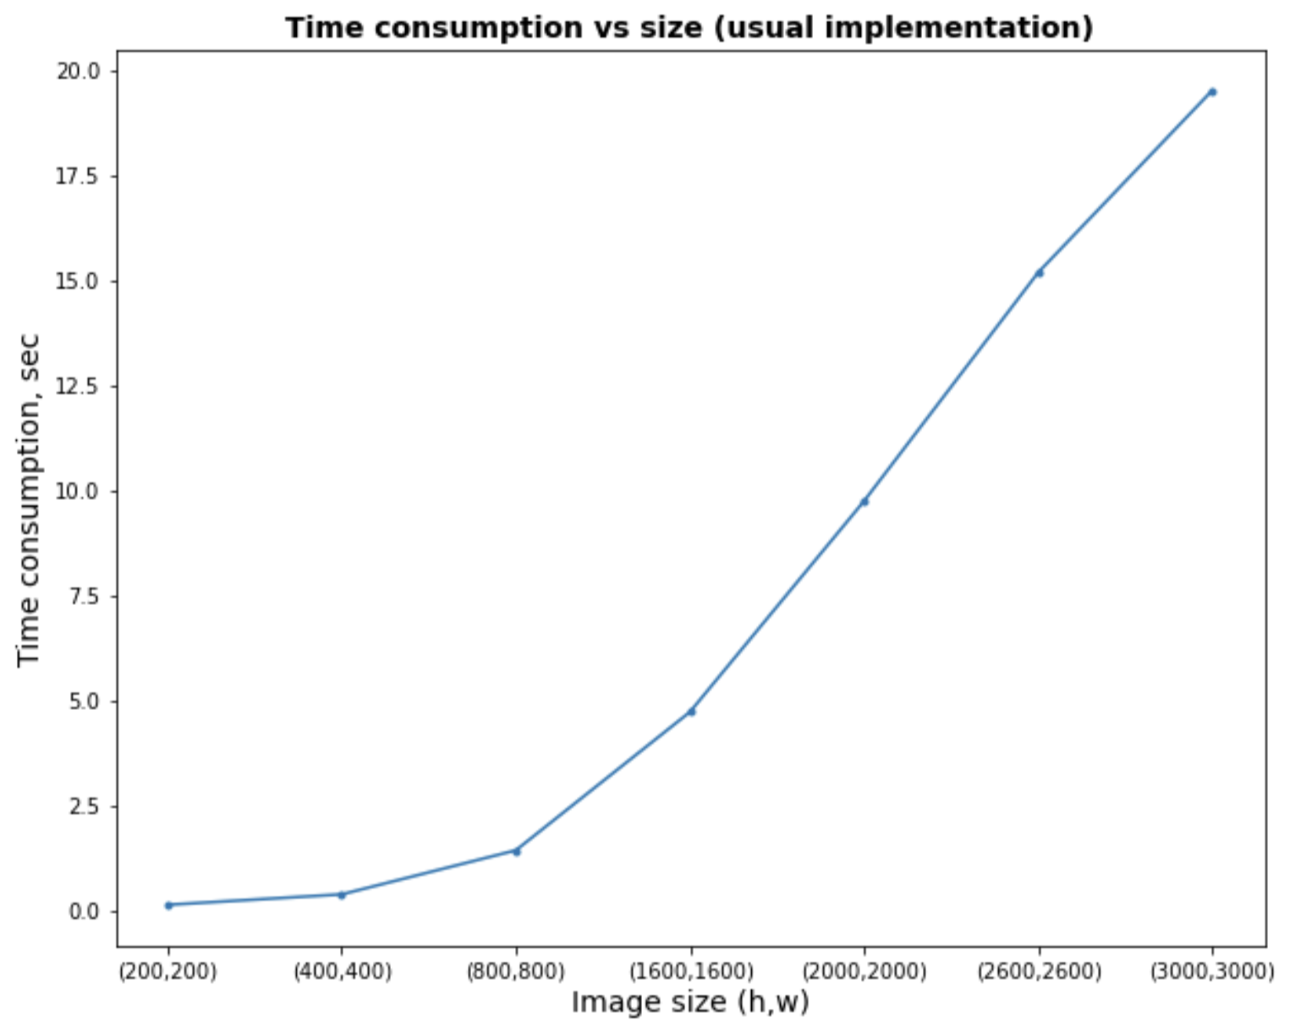

Slide 7
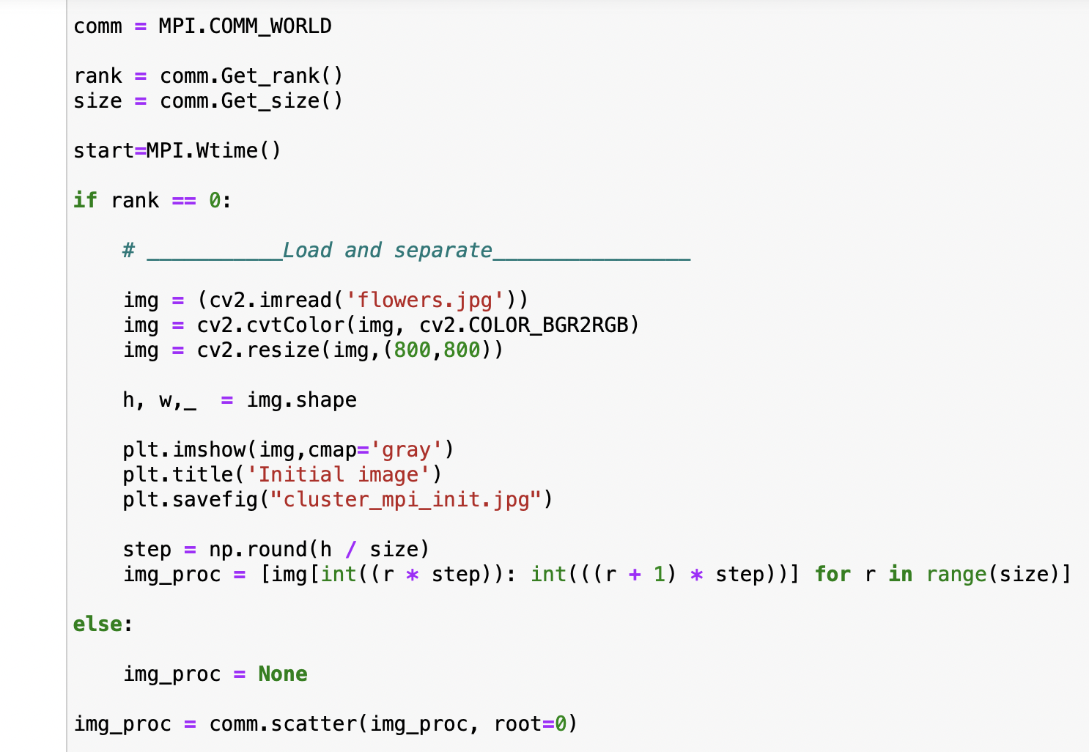

Slide 8
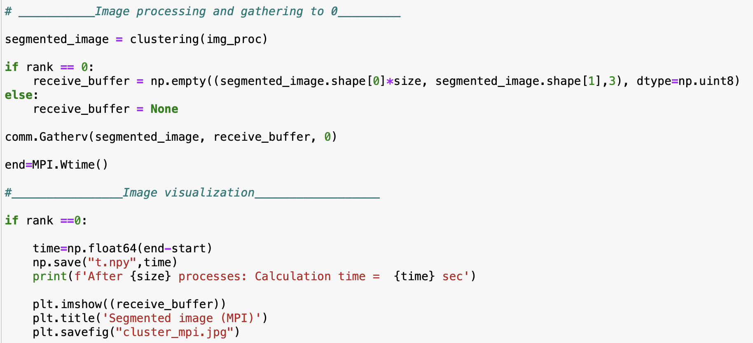

Slide 9
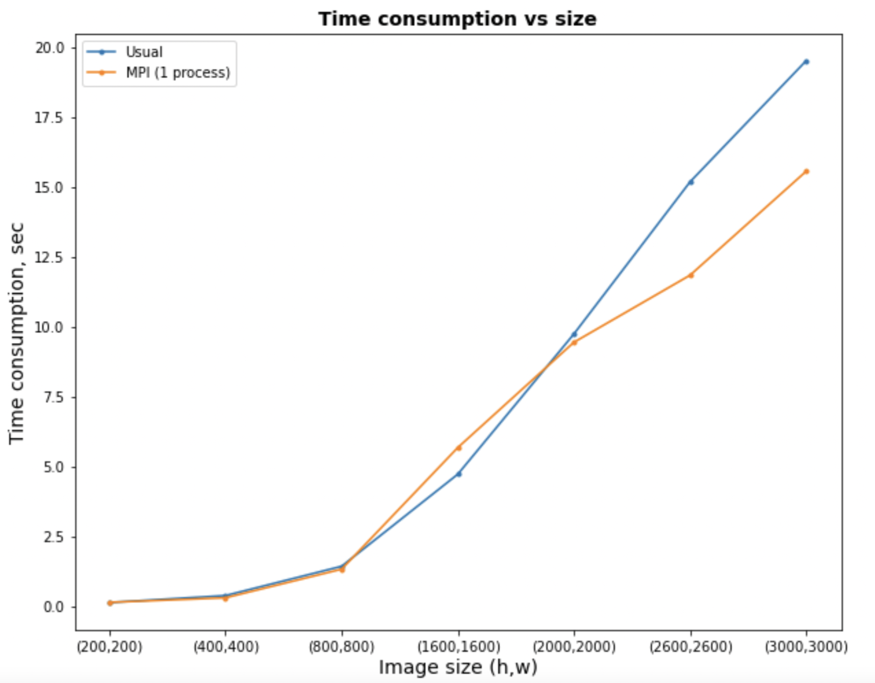

Slide 10
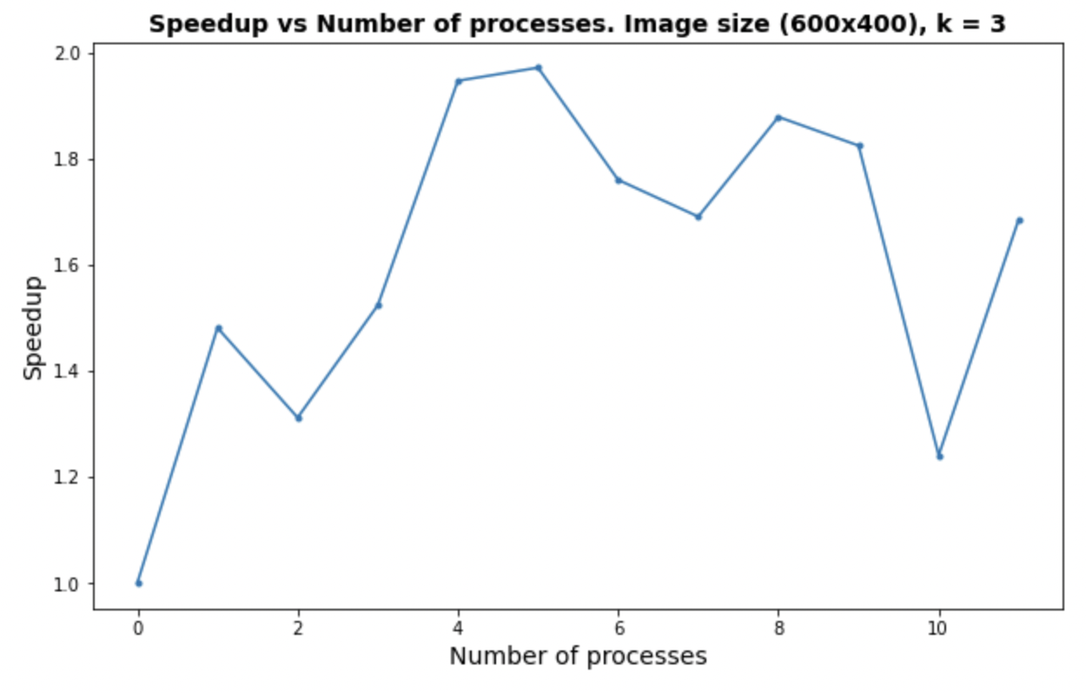
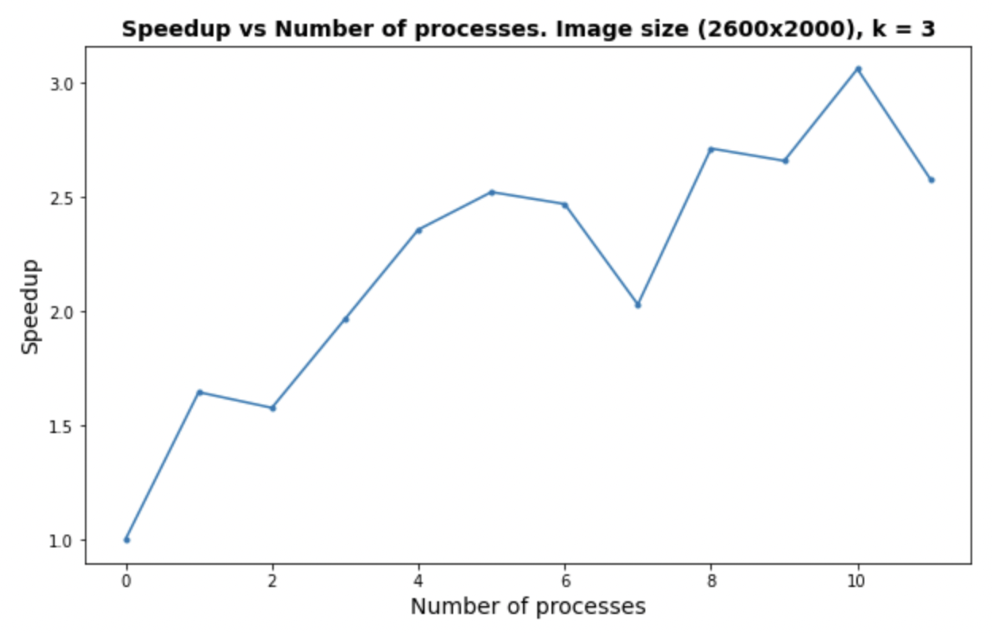
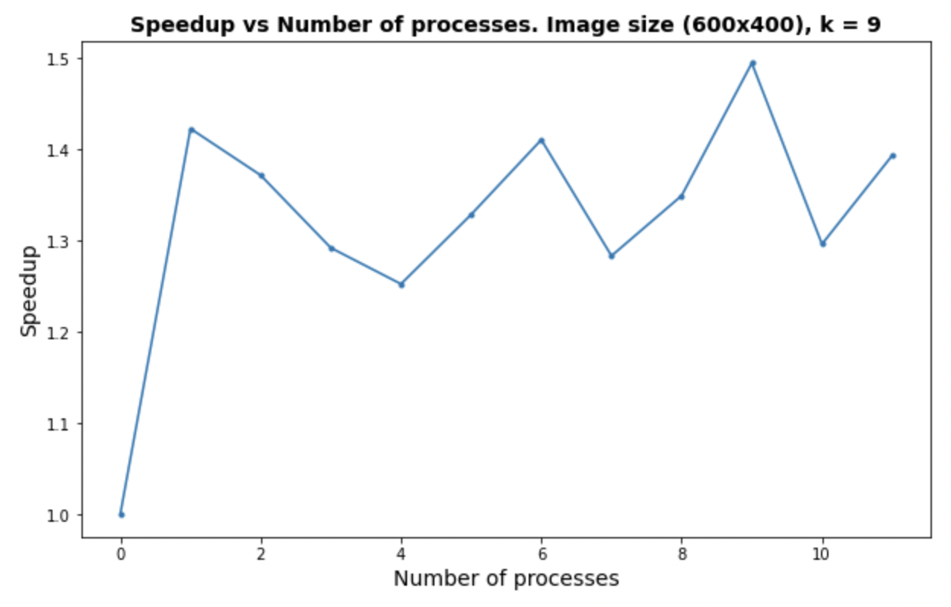
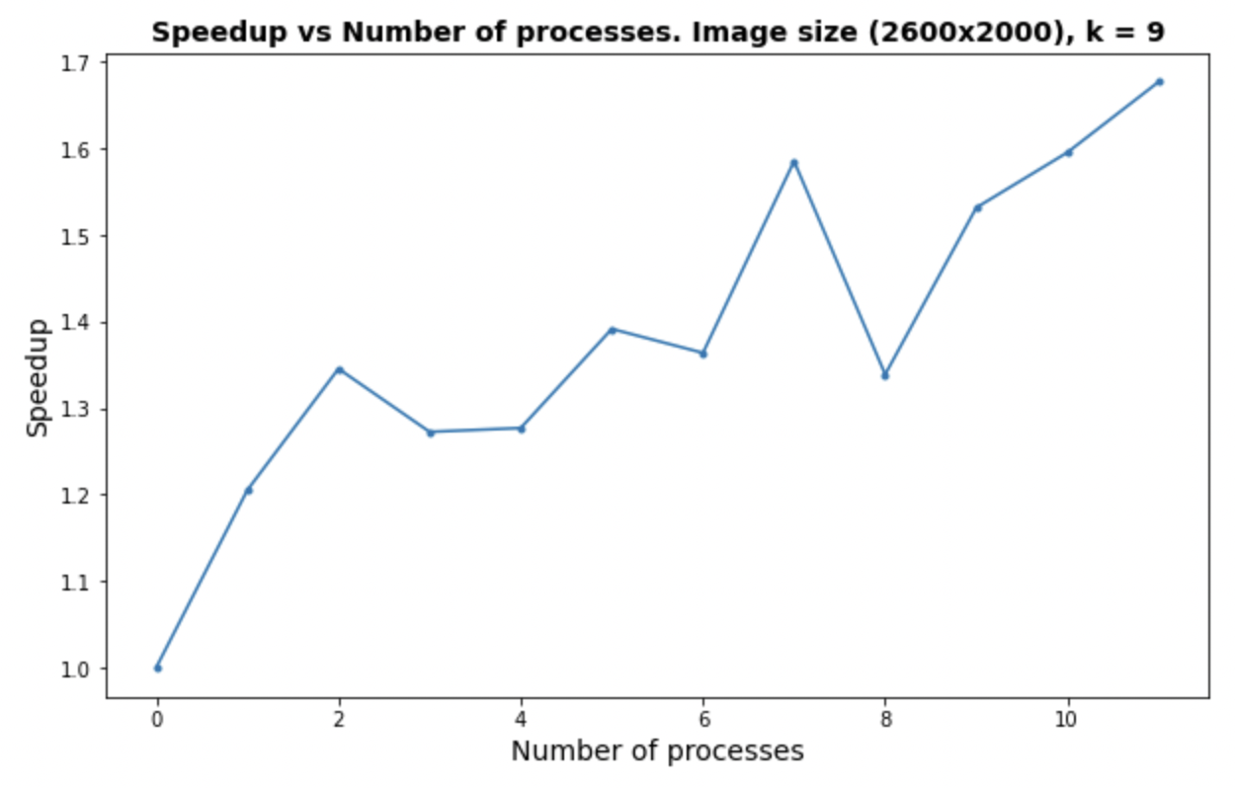
MS
MP
MS
MP

Slide 11
1. On little images there is no reason to use more than 5 processes
3. On large images we can achieve good speedup if use more than 8 processes
2. On little images with greater number of clusters we need more than 5 processes to achieve some speedup
4. On large images with greater k we need to use more than 12 processes to see good speedup

